Slide 1

CM20315 - Machine Learning
Prof. Simon Prince
3. Shallow Neural Networks

Slide 2
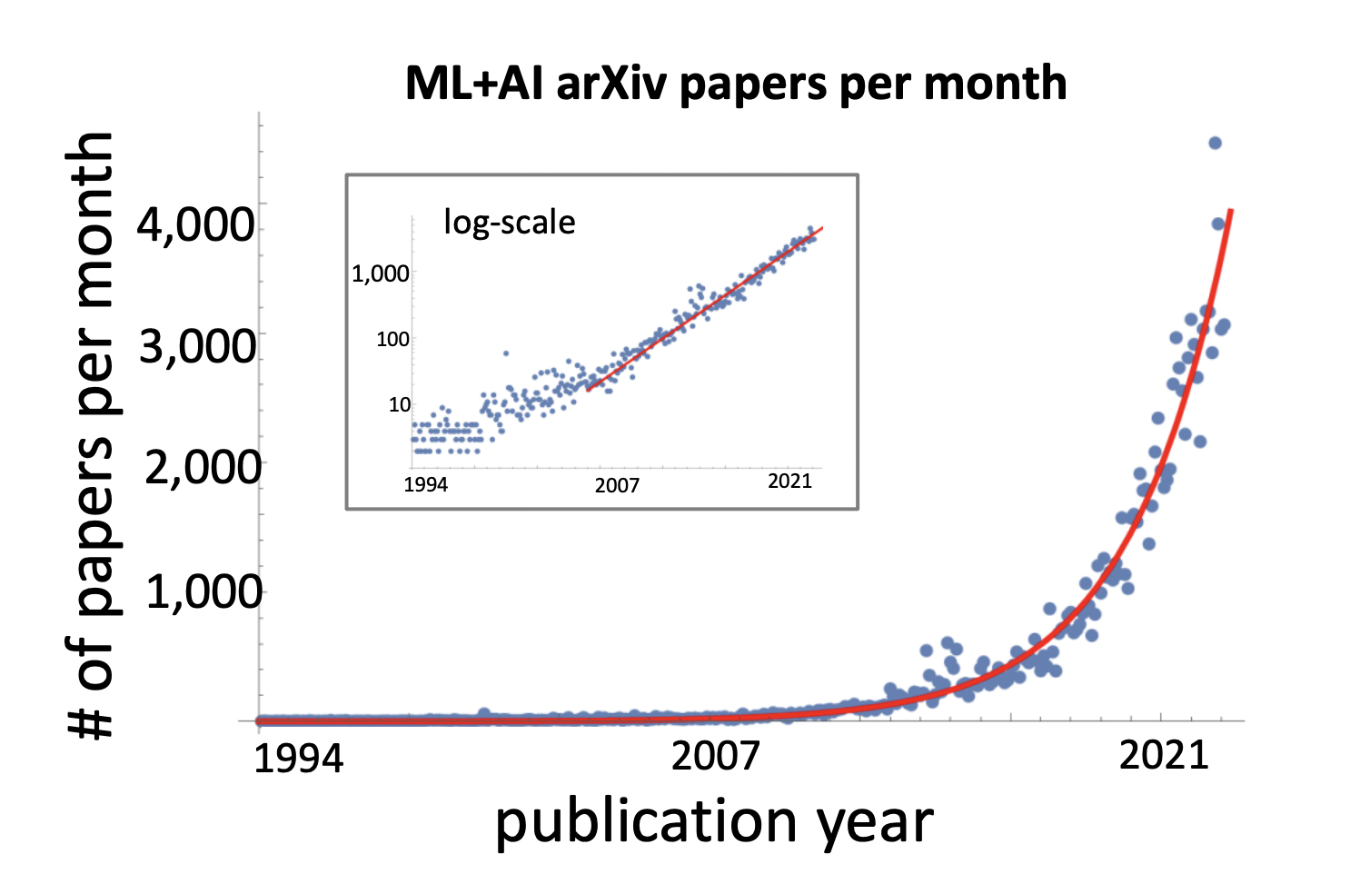

Slide 3

+ imagen video
+ dream fusion

Slide 4
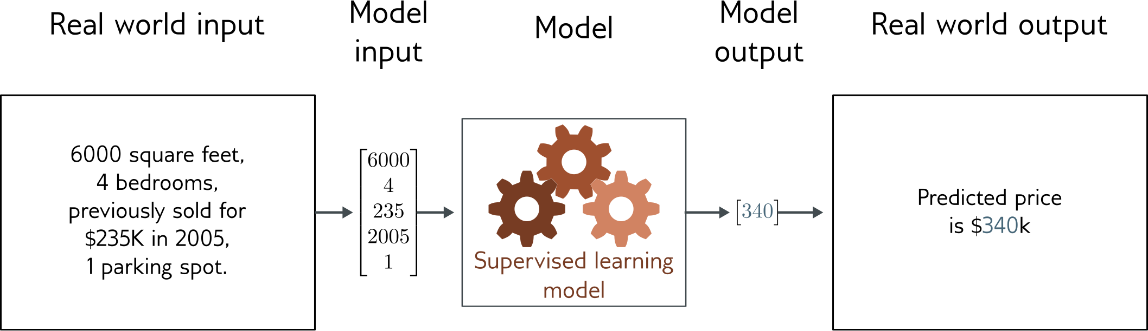
Regression
Univariate regression problem (one output, real value)
Fully connected network

Slide 5
Example: 1D Linear regression loss function
Loss function:
“Least squares loss function”

Slide 6
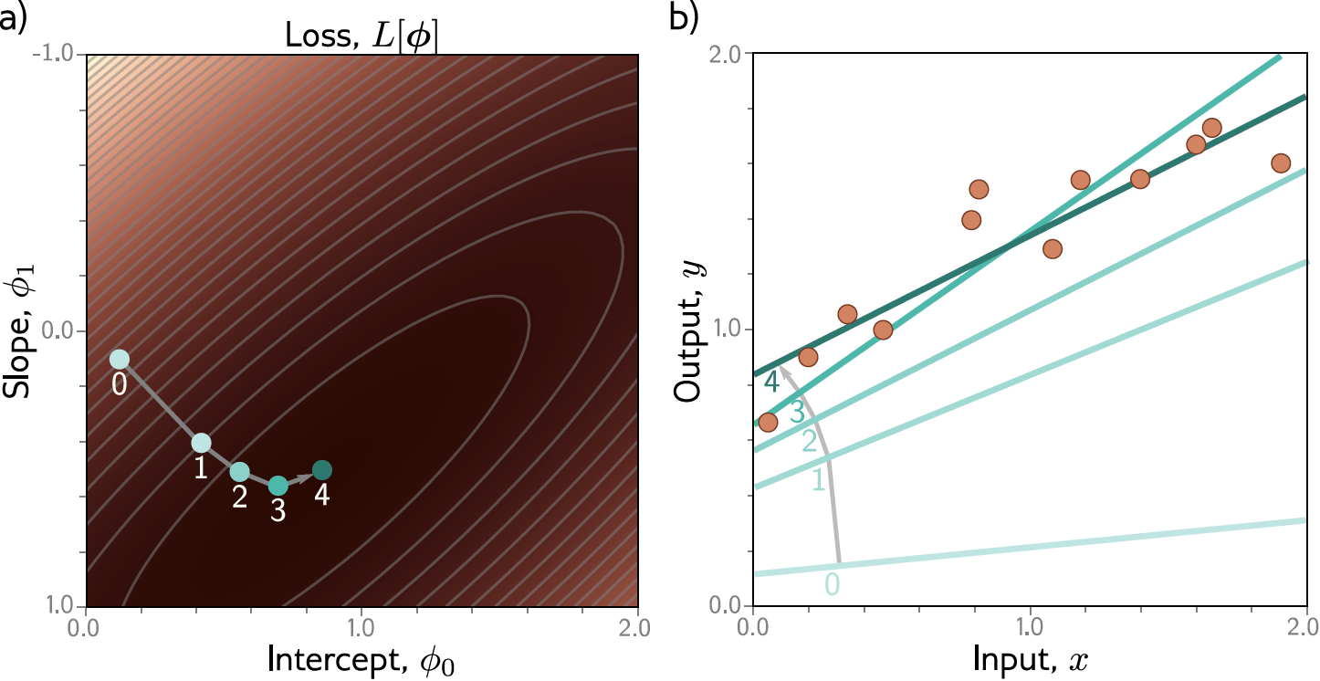
Example: 1D Linear regression training
This technique is known as gradient descent

Slide 7
Shallow neural networks
1D regression model is obviously limited
Want to be able to describe input/output that are not lines
Want multiple inputs
Want multiple outputs
Shallow neural networks
Flexible enough to describe arbitrarily complex input/output mappings
Can have as many inputs as we want
Can have as many outputs as we want

Slide 8
Shallow neural networks
Example network, 1 input, 1 output
Universal approximation theorem
More than one output
More than one input
General case
Number of regions
Terminology

Slide 9
1D Linear Regression
Example shallow network

Slide 10
Example shallow network

Slide 11
Example shallow network
Activation function

Slide 12
Example shallow network
Activation function
Rectified Linear Unit
(particular kind of activation function)

Slide 13
Example shallow network
Activation function
Rectified Linear Unit
(particular kind of activation function)

Slide 14
Example shallow network
This model has 10 parameters:
Represents a family of functions
Parameters determine particular function
Given parameters can perform inference (run equation)
Given training dataset
Define loss function (least squares)
Change parameters to minimize loss function

Slide 15
Example shallow network

Slide 16
Example shallow network
Piecewise linear functions with three joints

Slide 17
Hidden units
Break down into two parts:
where:
Hidden units

Slide 18
1. compute three linear functions

Slide 19
2. Weight the hidden units

Slide 20
2. Pass through ReLU functions to
compute hidden units

Slide 21
2. Pass through ReLU functions to
compute hidden units

Slide 22
Example shallow network
Example shallow network = piecewise linear functions
1 “joint” per ReLU function

Slide 23
Activation pattern = which hidden units are activated
Shaded region:
Unit 1 active
Unit 2 inactive
Unit 3 active

Slide 24
Depicting neural networks
Each parameter multiplies its source and adds to its target

Slide 25
Depicting neural networks

Slide 26
Shallow neural networks
Example network, 1 input, 1 output
Universal approximation theorem
More than one output
More than one input
General case
Number of regions
Terminology

Slide 27
With 3 hidden units:
With D hidden units:

Slide 28
With enough hidden units…
… we can describe any 1D function to arbitrary accuracy

Slide 29
Universal approximation theorem
“a formal proof that, with enough hidden units, a shallow neural network can describe any continuous function on a compact subset of to arbitrary precision”

Slide 30
Shallow neural networks
Example network, 1 input, 1 ouput
Universal approximation theorem
More than one output
More than one input
General case
Number of regions
Terminology

Slide 31
Two outputs
1 input, 4 hidden units, 2 outputs

Slide 32
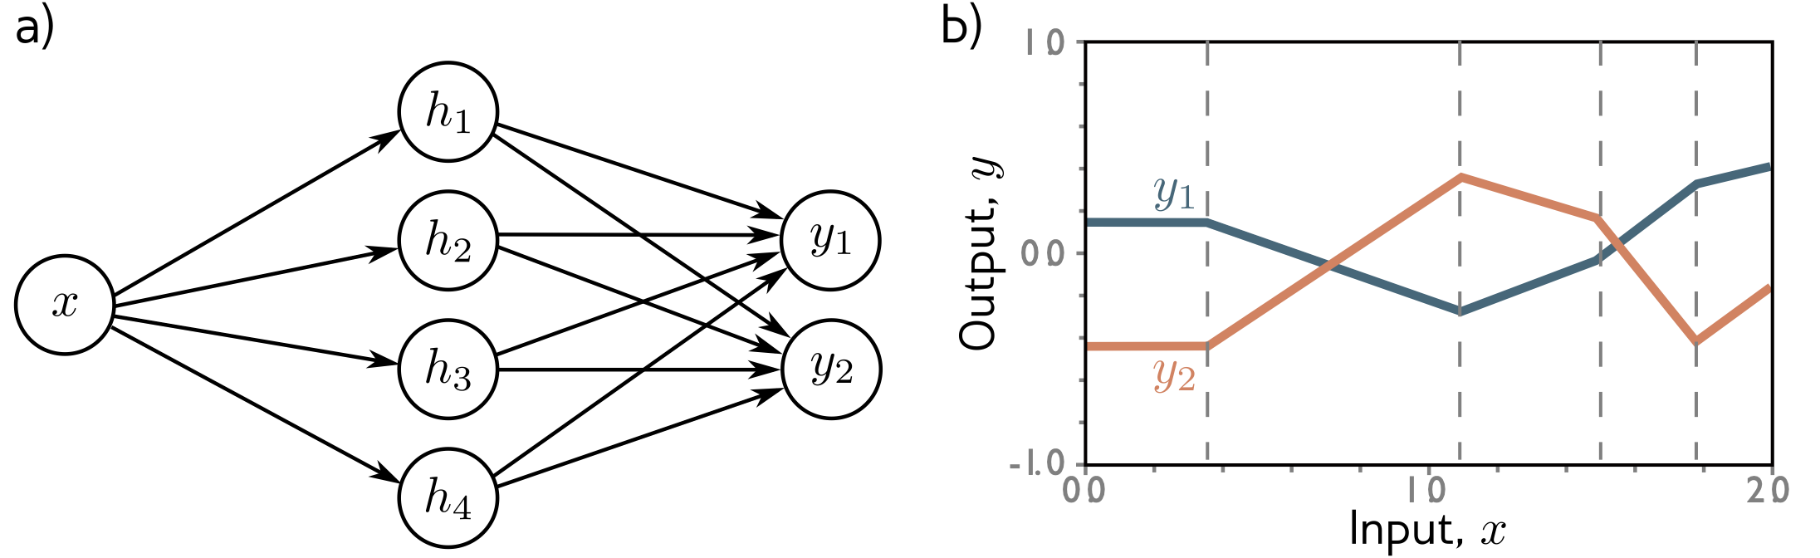
Two outputs
1 input, 4 hidden units, 2 outputs

Slide 33
Two outputs
1 input, 4 hidden units, 2 outputs

Slide 34
Shallow neural networks
Example network, 1 input, 1 ouput
Universal approximation theorem
More than one output
More than one input
General case
Number of regions
Terminology

Slide 35
Two inputs
2 inputs, 3 hidden units, 1 output

Slide 36
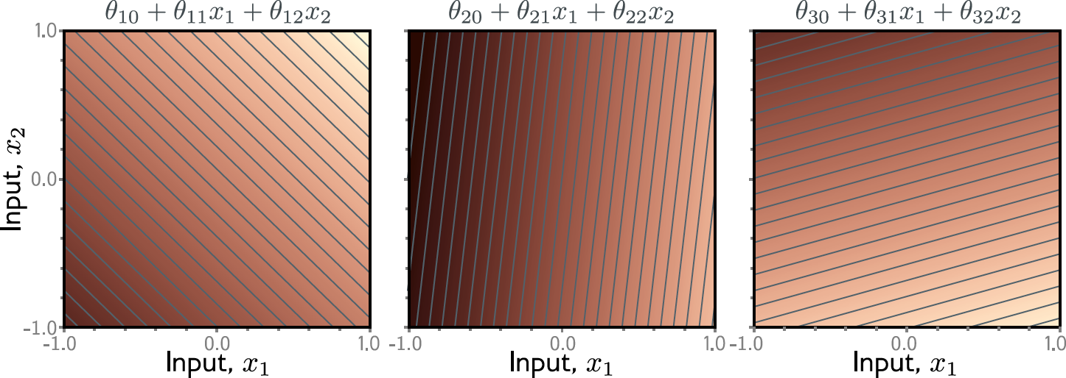

Slide 37
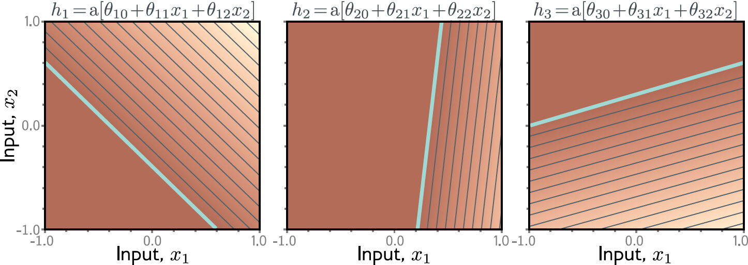

Slide 38
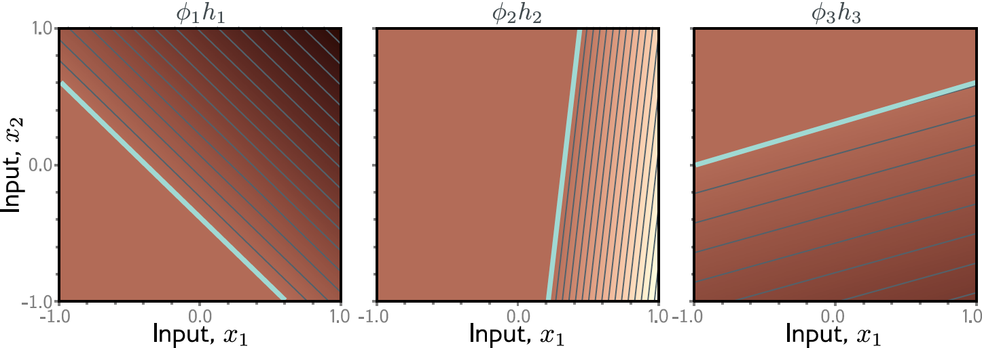

Slide 39
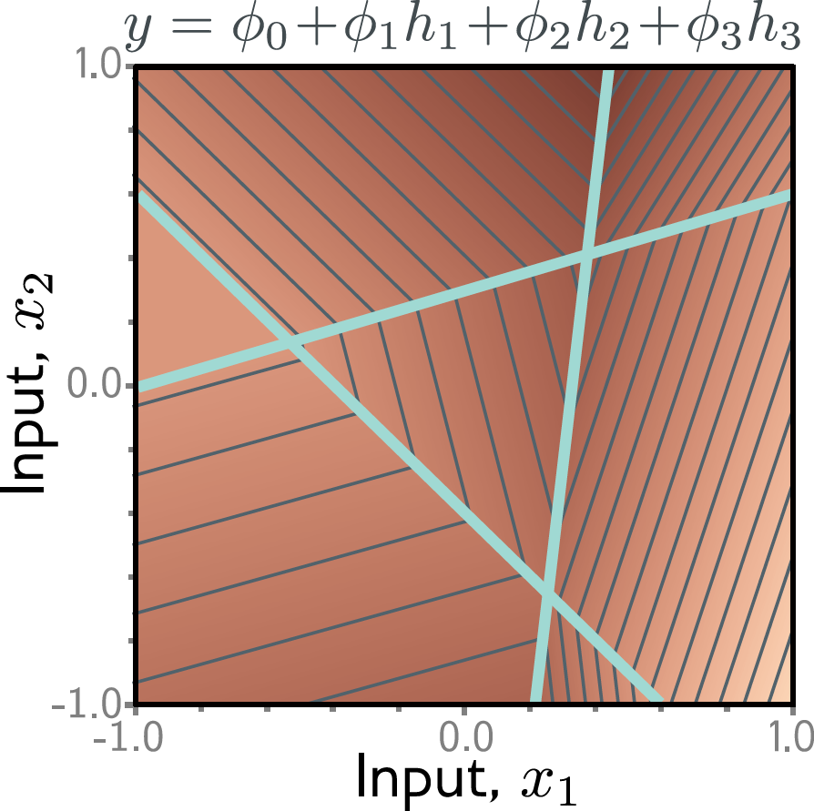

Slide 40
Convex polygons

Slide 41
Question 1:
For the 2D case, what if there were two outputs?
If this is one of the outputs, what would the other one look like?

Slide 42
Shallow neural networks
Example network, 1 input, 1 ouput
Universal approximation theorem
More than one output
More than one input
General case
Number of regions
Terminology

Slide 43
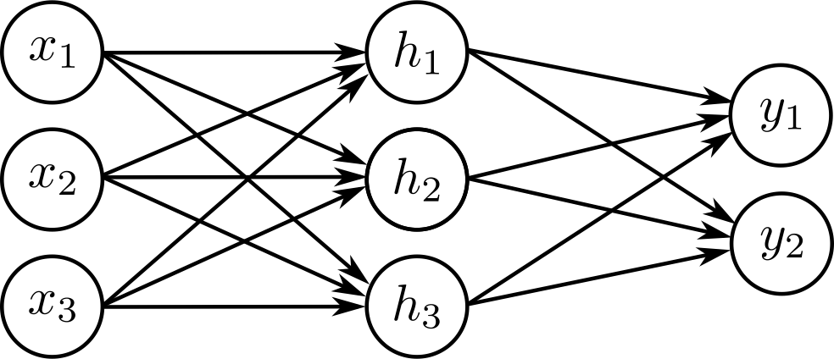

Arbitrary inputs, hidden units, outputs
$D_{o}$Outputs, D hidden units, and $D_{i}$ inputs
e.g., Three inputs, three hidden units, two outputs

Slide 44
Question 2:
How many parameters does this model have?

Slide 45
Shallow neural networks
Example network, 1 input, 1 ouput
Universal approximation theorem
More than one output
More than one input
General case
Number of regions
Terminology

Slide 46
Number of output regions
In general, each output consists of D dimensional convex polytopes
With two inputs, and three outputs, we saw there were seven polygons:

Slide 47
Number of output regions
In general, each output consists of D dimensional convex polytopes
How many?
Highlighted point = 500 hidden units or 51,001 parameters

Slide 48
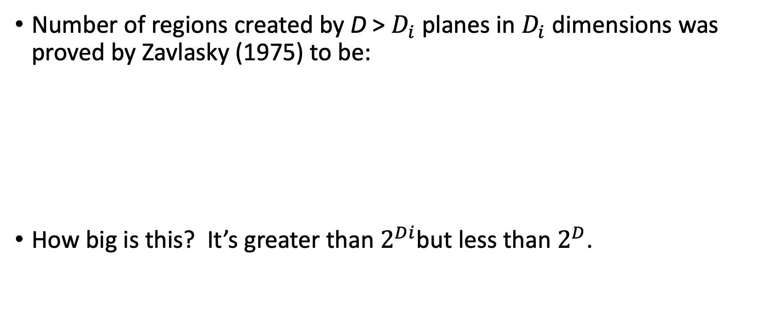
Number of regions:
Number of regions created by D > $D_{i}$ planes in $D_{i}$ dimensions was proved by Zavlasky (1975) to be:
How big is this? It’s greater than $2^{Di}$but less than $2^{D}$.
Binomial coefficients!

Slide 49

Proof that bigger than larger than $2^{Di}$
1D input with 1 hidden
unit creates two regions
(one joint)
2D input with 2 hidden
units creates four regions
(two lines)
3D input with D hidden
units creates eight regions
(three planes)

Slide 50
Shallow neural networks
Example network, 1 input, 1 ouput
Universal approximation theorem
More than one output
More than one input
General case
Number of regions
Terminology

Slide 51
Nomenclature

Slide 52
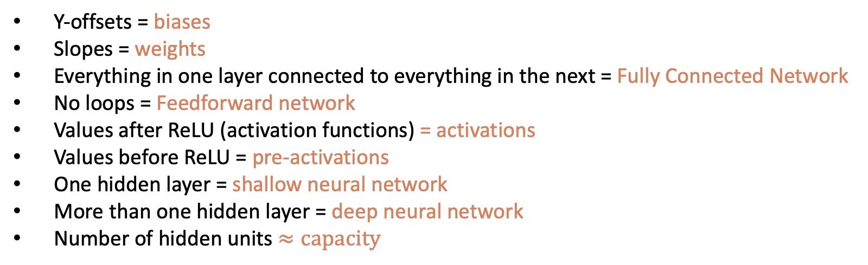
Nomenclature
Y-offsets = biases
Slopes = weights
Everything in one layer connected to everything in the next = Fully Connected Network
No loops = Feedforward network
Values after ReLU (activation functions) = activations
Values before ReLU = pre-activations
One hidden layer = shallow neural network
More than one hidden layer = deep neural network
Number of hidden units $≈capacity$

Slide 53
Other activation functions

Slide 54
Regression
We have built a model that can:
take an arbitrary number of inputs
output an arbitrary number of outputs
model a function of arbitrary complexity between the two

Slide 55
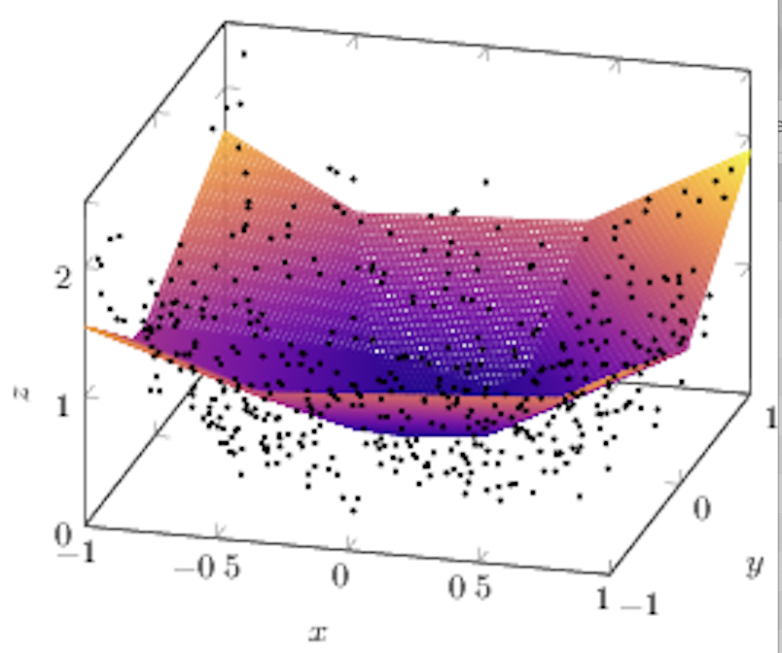

Slide 56
Next time:
What happens if we feed one neural network into another neural network?

